Slide 1

STATED AND UNSTATED REQUIREMENTS

Slide 2

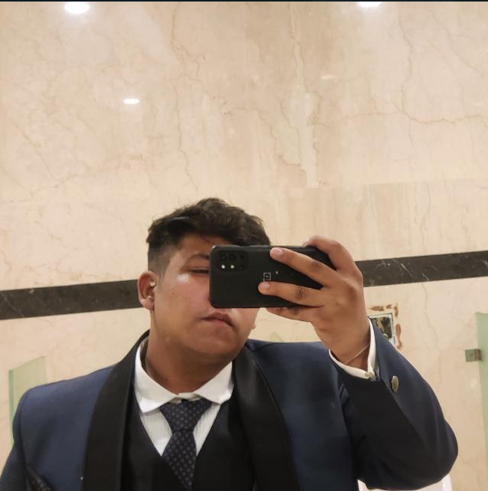
TEAM MEMBERS
JAI khandelwal
Ra2112704010025.
Godfrey ashwanth
RA2112704010020.
Sujal Singh
RA211270401001
PONNURI ANIRUDDHA
RA2112704010015

Slide 3

Unstated requirements
Chef to be qualified and experienced
New restaurant tools increased profits by $20 million in 2019 ​
Loss of potential income by not offering new tools for restaurant workers ​
Service industry professionals want something that’s easy to adopt and simple to use for their restaurant​

Slide 4
Unstated requirements
Market gap
Customers
Financials
Restaurants need new software solutions but are using old or outdated tools and services​
10% increase of POS efficiency prove that there’s a market for simpler POS tools​
New restaurant tools increased profits by $20 million in 2019 ​
Costs
Usability
Loss of potential income by not offering new tools for restaurant workers ​
Service industry professionals want something that’s easy to adopt and simple to use for their restaurant​

Slide 5
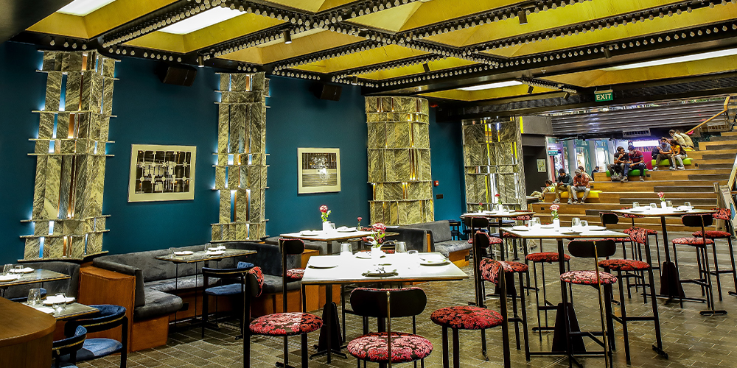
stated requirements
Market gap
Customers
Financials
Restaurants need new software solutions but are using old or outdated tools and services​
10% increase of POS efficiency prove that there’s a market for simpler POS tools​
New restaurant tools increased profits by $20 million in 2019 ​
Costs
Usability
Loss of potential income by not offering new tools for restaurant workers ​
Service industry professionals want something that’s easy to adopt and simple to use for their restaurant​

Slide 6
stated requirements
Market gap
Customers
Financials
Restaurants need new software solutions but are using old or outdated tools and services​
10% increase of POS efficiency prove that there’s a market for simpler POS tools​
New restaurant tools increased profits by $20 million in 2019 ​
Costs
Usability
Loss of potential income by not offering new tools for restaurant workers ​
Service industry professionals want something that’s easy to adopt and simple to use for their restaurant​

Slide 7


